Slide 1

CarDiag
UNIVERSITY OF BUEA FACULTY OF ENGINEERING & TECHNOLOGY
CEF 440 · TASK 5
UI Design & Implementation
Designing and building CarDiag — your pocket car-diagnostic assistant. An assistant, not a replacement.
PRESENTED BY GROUP 8
Salle Yimnai Bryan Nzume Etuge
Manikeu Tinkeu Marie Ange
Fongang Faith Acho
Andigema Joyce Ani
Ndip Samuel Agbor Ojong
INSTRUCTOR DR NKEMENI VALERY

Slide 2

THE BRIEF
Task 5 delivers three things that turn an idea into a real, running app.
01
02
03
App Identity
Visual Design
Frontend Build
A recognisable, trustworthy character — name, logomark, tagline and the promise that governs every screen.
A complete, accessible, token-based design system — colour, type, shape, icons and components.
A native Android app in Kotlin & Jetpack Compose — all 16 screens, fully offline, backend-ready.
Built for trust. CarDiag helps a non-technical driver understand a problem and decide the next step — a qualified mechanic still confirms the fix.
CARDIAG · CEF 440 TASK 5
02 / 21

Slide 3
PART ONE
App Identity
The recognisable, repeatable signals that tell a user what CarDiag is, who it is for, and how it behaves — the foundation of trust for a tool that touches driver safety.
Name & wordmark
Pulse-shield logomark
Tagline & promise
Personality & voice
CARDIAG · CEF 440 TASK 5
03 / 21

Slide 4
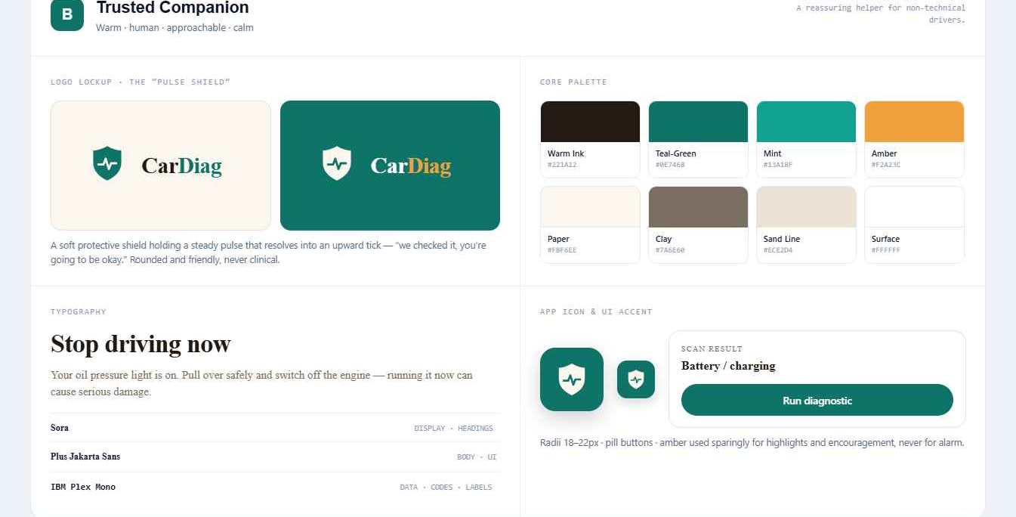
APP IDENTITY · THE ESSENTIALS
PRODUCT NAME
CarDiag
A contraction of “Car Diagnosis” — short, pronounceable, descriptive. The diagnostic half is emphasised in brand green.
LOGOMARK
A shield holding a pulse
The shield says protection and trust; the heartbeat line says diagnosis and vital signs. One scalable vector, light & inverted finishes.
TAGLINE & PROMISE
“Your pocket diagnostic” · Works fully offline
The deeper promise governs every result screen: “An assistant, not a replacement.”
FIGURE 1 — THE CARDIAG BRAND BOARD · “TRUSTED COMPANION”
APP IDENTITY
04 / 21

Slide 5
BRAND PERSONALITY & VOICE
Calm, plain-spoken and protective — never alarmist, never over-claiming.
CarDiag explains a fault in everyday terms — “Possible engine timing problem. Visit a mechanic soon” — not “potential crankshaft synchronisation anomaly”.
Honest
Calm
Protective
Plain-spoken
Accessible
Confidence is always shown; low confidence never names a fault.
Warm palette, generous spacing, no harsh reds except real danger.
Safety disclaimer on every result; non-dismissible critical warnings.
Short sentences, everyday words, one clear “Do this first”.
A non-technical owner completes a check in no more than three taps.
APP IDENTITY
05 / 21

Slide 6
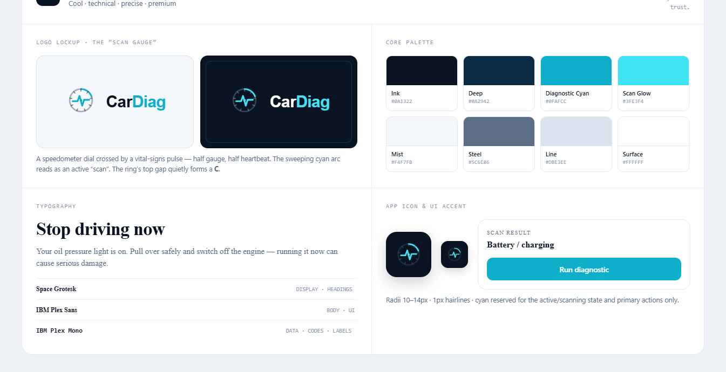

BRAND DIRECTION SELECTION
Two directions were prototyped. We chose the reassuring one.
Selected
Rejected
Direction A — “Diagnostic Instrument”
Production identity
Direction B — “Trusted Companion”
Cool, technical, high-contrast — cyan on near-black with a gauge logomark. Reads as a precision tool, but clinical.
Warm, friendly, reassuring — deep green on soft paper, rounded shapes, the pulse-shield. A human, low-anxiety guide that supports adoption.
APP IDENTITY
06 / 21

Slide 7
PART TWO
Visual Design
A small, consistent token-based design system — one source of colour, type, spacing, shape, iconography and components that every screen draws from.
›
Clarity over completeness
›
Safety is non-negotiable
›
Honest uncertainty
›
Offline by default
›
Reachable in three taps
›
Never colour alone
CARDIAG · CEF 440 TASK 5
07 / 21

Slide 8
COLOUR SYSTEM
A warm, low-glare palette. Colour is used sparingly so urgency always stands out.
Background
Surface
Surface-2
Ink
Muted
Faint
#FBF6EE
#FFFFFF
#F5EEE2
#221A12
#7A6E60
#A99C8C
Line
#ECE2D4
Deep-green brand accents on a soft-paper canvas. Amber is reserved for highlights and encouragement — never for alarm.
VISUAL DESIGN
08 / 21

Slide 9




THE URGENCY COLOUR SYSTEM · FR08 · NFR11
Every result is one of four levels — colour + label + a plain action. Never colour alone.
Low
Medium
High
Critical
MONITOR
SERVICE SOON
MECHANIC TODAY
STOP NOW
Safe to keep driving — service at the next routine check.
Not an emergency — book a mechanic within a few days.
Visit a mechanic today — driving on risks a costlier fault.
Stop driving as soon as it is safe — a non-dismissible prompt confirms.
VISUAL DESIGN
09 / 21

Slide 10
TYPOGRAPHY
Three voices — confident display, friendly body, precise mono.
Aa
Aa
Aa
Sora
Plus Jakarta Sans
IBM Plex Mono
DISPLAY · HEADINGS
BODY · UI
DATA · LABELS
Screen titles, section headers, result names. Geometric and confident.
All reading copy. Humanist, friendly, legible at small sizes.
Eyebrow labels, numeric values, metadata. Signals precision.
All loaded as downloadable Google Fonts with a safe system fallback — no font binaries shipped, graceful degradation if unavailable.
VISUAL DESIGN
10 / 21

Slide 11
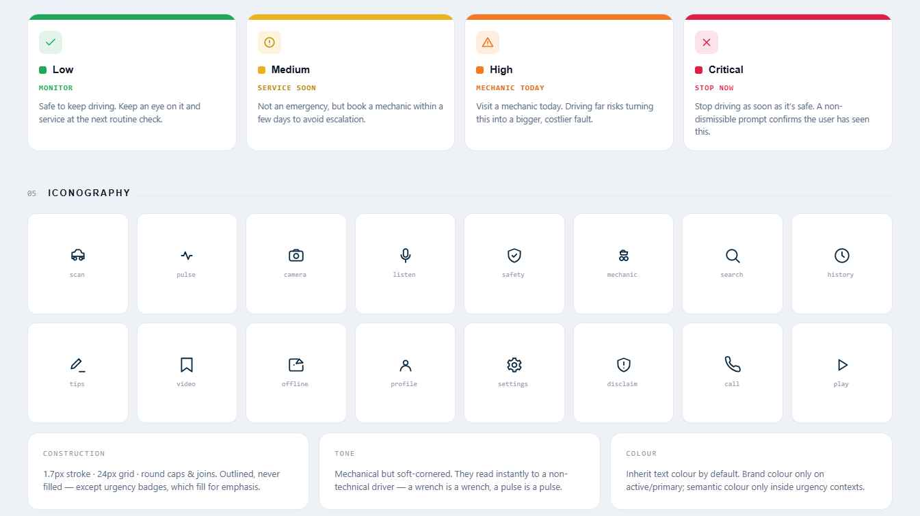
ICONOGRAPHY, SPACING & SHAPE
Two icon sets, drawn as one family.
A 24-unit grid , 1.7px stroke, round caps & joins — outlined, never filled (except urgency badges). Interface icons for navigation, actions and status; plus eight real dashboard warning-light symbols so users can match what they see.
SPACING
SHAPE
Rhythm of four
Rounded · pill
ELEVATION
DRAWN AS
Hairline + faint
Vectors, any DPI
FIGURE 3 — URGENCY SCALE + THE INTERFACE ICON FAMILY
VISUAL DESIGN
11 / 21

Slide 12

CORE COMPONENTS & ACCESSIBILITY
A compact component library — each defined once, themed by tokens.
Card / list row
Pill buttons
Accessibility, by construction
Icon tile · title · meta · chevron
Primary · ghost · subtle · danger
WCAG 2.1 AA contrast on the paper background
Urgency badge
Confidence meter
Urgency = colour + label + action + icon, never colour alone
Dot + level + action phrase
Animated bar + band + %
Comfortable touch targets; one large primary action
Plain language; scalable units reflow rather than break
Safety disclaimer
Sheets & modals
On every result (FR13)
Bottom sheet · centred modal
Bottom nav · chips
Four destinations · filters
VISUAL DESIGN
12 / 21

Slide 13
SCREEN INVENTORY · §3.8
Sixteen screens, every requirement served.
16
01
Splash
02
Onboarding
03
Permissions
04
Home hub
Brand lockup · routes onward
Three intro slides
Camera & mic rationale
Entry to all pathways
05
Camera scan
06
Result
07
Manual search
Aim-and-capture · offline
Fault · urgency · confidence
Offline light dictionary
13
History
14
History detail
15
Vehicle garage
16
Settings
Saved diagnoses + filters
View · edit note · delete
Add · switch · edit · remove
Contacts · privacy · language
VISUAL DESIGN
13 / 21

Slide 14
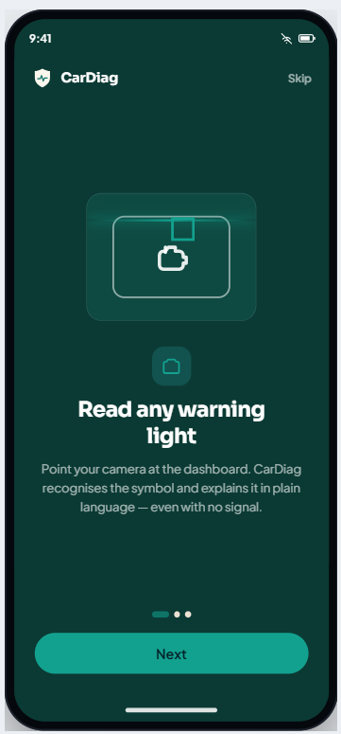
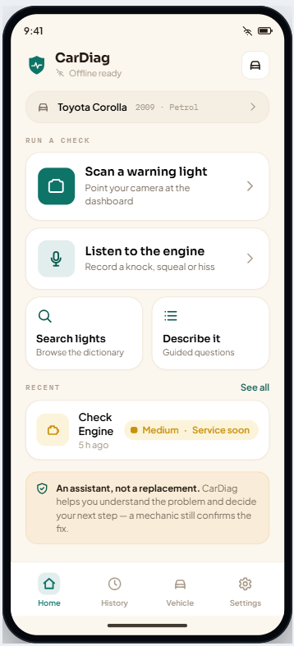
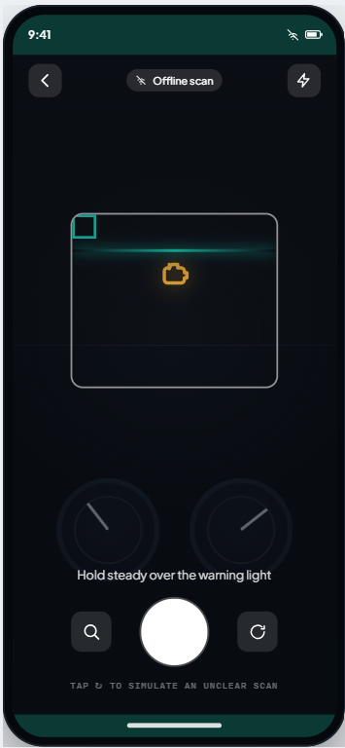
UI WALKTHROUGH · EVERY CHECK, ONE TAP FROM HOME
Three diagnostic pathways — scan, listen, or search.
ONBOARDING — THE THREE PATHWAYS
HOME HUB — ONE TAP TO ANY CHECK
CAMERA SCAN — FULLY OFFLINE
UI WALKTHROUGH
14 / 21

Slide 15
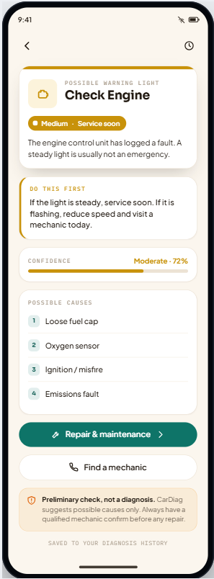
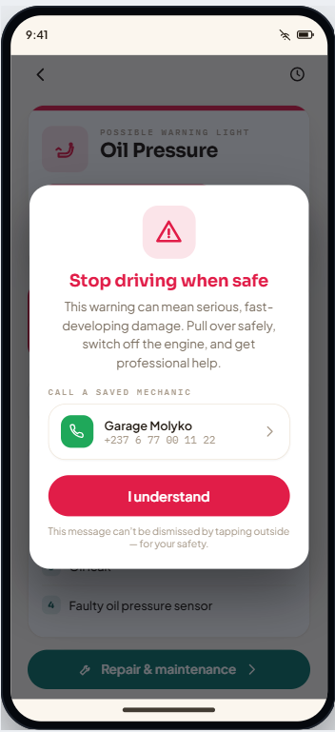
RESULT & SAFETY · THE TRUST MODEL
“Do this first”
A bordered card gives the single most important action before any detail.
Confidence, always shown
Low confidence refuses to name a fault and routes to manual search instead of guessing.
Safety interrupts, deliberately
Critical faults can’t be dismissed by tapping outside, hold the button for 3 s, and offer one-tap dialling of a saved mechanic.
RESULT — URGENCY, CONFIDENCE, CAUSES
CRITICAL — NON-DISMISSIBLE PROMPT
UI WALKTHROUGH
15 / 21

Slide 16
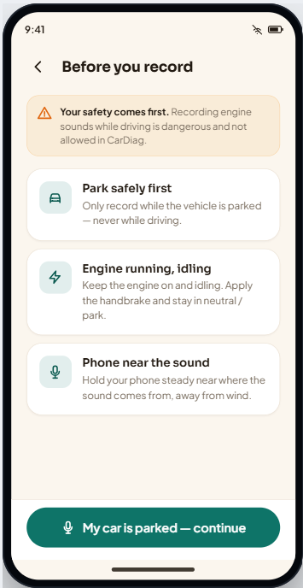
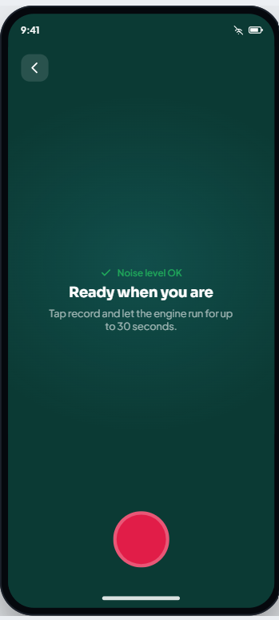
THE ENGINE-SOUND PATHWAY · INTENTIONALLY SLOW & CAREFUL
Park first. Listen safely.
A safety gate lists the rules — park, engine idling, phone near the sound — and keeps Continue disabled for four seconds.
Recording runs on a dark, focused screen with a live waveform, a 30-second limit and an ambient-noise check first.
A short set of follow-up questions then refines the assessment before it is shown.
FR05 · Record
FR07 · Follow-up
FR18 · Safety gate
SAFETY GATE (TIMED)
RECORDING + AMBIENT CHECK
UI WALKTHROUGH
16 / 21

Slide 17
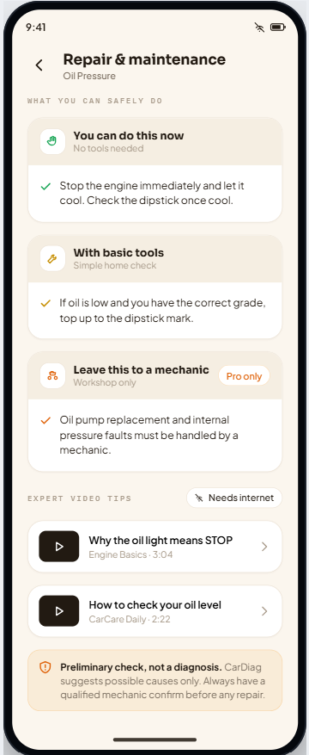
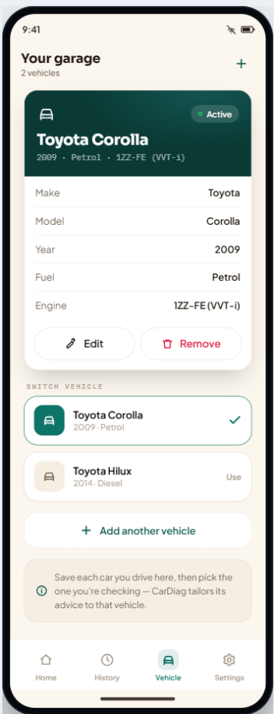
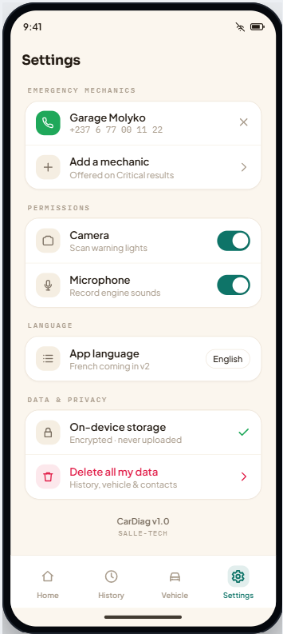
REPAIR GUIDANCE, THE GARAGE & PRIVACY
Three safety tiers, your vehicles, your data.
REPAIR — “NOW / BASIC TOOLS / PRO ONLY”
GARAGE — SAVE & SWITCH VEHICLES
SETTINGS — CONTACTS & PRIVACY
UI WALKTHROUGH
17 / 21

Slide 18
PART THREE
Frontend Implementation
A native Android app in Kotlin & Jetpack Compose — all sixteen screens, running fully offline, structured so the database and ML models of Task 6 attach without changing the UI.
CARDIAG · CEF 440 TASK 5
18 / 21

Slide 19
ARCHITECTURE · MVVM, BACKEND-READY
The UI depends on interfaces — so the backend attaches by addition, not rewrite.
View · Compose screens
16 screens + library
THE ML / DATA SEAM
↑ renders state · raises events ↓
interface DiagnosisService {
fun simulateScan(): DiagnosisResult
fun analyzeSound(): DiagnosisResult
fun guidedAssessment(area): DiagnosisResult
}
ViewModel · UI state + back-stack
↓ talks only to abstractions
Repository & Service interfaces
Today → Mock
Task 6 → Room/SQLite
→ Retrofit sync
the seam · CarDiagRepository · DiagnosisService
→ TensorFlow Lite
↓ satisfied today by mocks
Model · pure Kotlin domain types
LANGUAGE
UI
Urgency enum carries its own colour, label & action
Kotlin 2.0
Compose · M3
MIN SDK
PATTERN
26 · Android 8
MVVM
FRONTEND IMPLEMENTATION
19 / 21

Slide 20
CHALLENGES & KEY DESIGN DECISIONS
Five decisions that turned tensions into a clear brief.
01
A reassuring identity over a technical one
02
Communicating uncertainty responsibly
“Trusted Companion” + “assistant, not a replacement” turned the trust tension into a design brief.
Confidence meter, fault-name suppression and the disclaimer are first-class, not optional.
03
Safety interruptions that are actually read
04
A frontend that won’t be rewritten
A non-dismissible modal with an enforced read delay — gentler banners for minor faults.
Routing all data through interfaces lets Task 6 add a real DB and models by addition.
05
Custom navigation for rich screen parameters
A small sealed-type router with a back-stack in the view-model — simpler, type-safe, and a faithful match to the prototype’s flow than string-argument navigation.
FRONTEND IMPLEMENTATION
20 / 21

Slide 21
Identity, design and a running app — delivered.
A recognisable, trustworthy character; a complete, accessible token-based design system; and a native Kotlin & Compose app that runs fully offline and is ready for the backend and on-device ML of Task 6.
An assistant, not a replacement
Works fully offline
Thank you.
CARDIAG · CEF 440 TASK 5 · GROUP 8
21 / 21

